Slide 1


Win/Loss Prediction in Major League Soccer using Deep Learning model
Team-11:
['Ben Reed',
'Daniel Gonzalez',
'M A Moonem',
'Sean Tyson']
August, 2021
Notes:
Moonem:
Good evening everyone!
Since, this is officially the end of this Boot Camp, I, on behalf of our team and my classmates, would like to express our heartfelt thanks and gratitude to our Instructor Teddy, who has been a passionate and dedicated teacher from the beginning of this course.
I must appreciate his instruction style - smiling, optimistic and encouraging.
I would also thank all the TAs - Artem, Geoff, Gael, David, Sara, Ritesh all other TAs for their friendly support.
Thanks to Nick, UT, Trilogy and people behind this amazing Boot Camp who created this outstanding content for the Modules.
[40 sec]

Slide 2

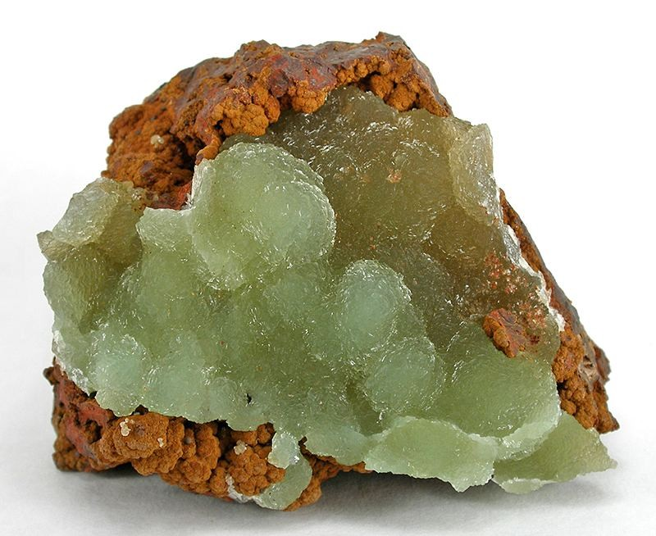

Topic
Win/Loss Prediction in Major League Soccer using Deep Learning model
Austinite
Reasons behind the topic:
We’re Austinite and we love Soccer.
Austin FC, a new member of the Western Conference, has had a hot start to the 2021 season.
We wanted to dig into the historic performance of rival clubs and develop a machine learning model to predict outcomes for our home team's first season.
Notes:
Moonem:
As we see our topic is to predict win/loss in a soccer match.
<go through bullet points>

Slide 3

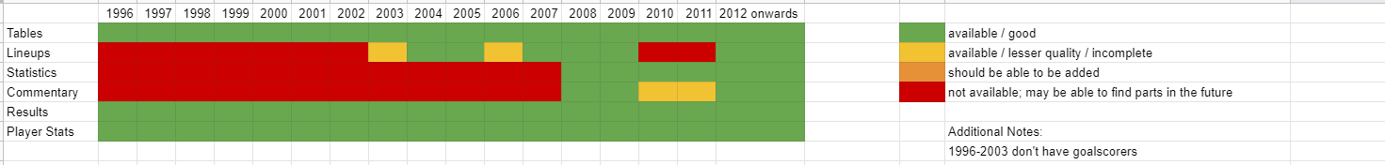
Data Source
Kaggle data,
Major League Soccer Dataset - by Joseph Mohr, last updated 11th July, 2021; version 34. The weblink: https://www.kaggle.com/josephvm/major-league-soccer-dataset
Contains player, game, event, goalkeeper, and table data on Major League Soccer (MLS)
Data from 1996-2021
Covers over 6000 matches, almost 420,000 events.
Data Quality:
Rated 8.8 for Data Usability.
We used from 2008 to 2021 because of mostly null data before then.
Notes:
Ben
We got our data from Kaggle
Where we’ve got four dataset in .csv format.
These are data from 1996-2021 on over 6000 matches.
As we see from the figue below, we could use data from 2008 onward because of plenty of null values in previous data.

Slide 4

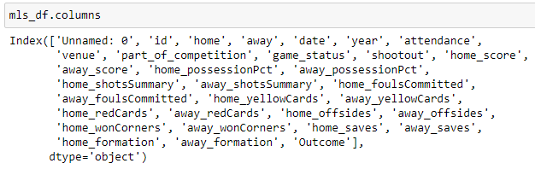
Finding answers from the data
The following figure shows the column headers which are essentially the FEATURES (X) and the last “outcome” column is the OUTCOME (y) for the Machine Learning Model.
As the headers say, we expect to relate a good prediction of outcome based on the feature columns.
Notes:
Ben:
If we look at the column headers, we see the selected KEY features are there,
Although we used only a few columns as FEATURES that can be known before a match starts

Slide 5

Data Exploration
Each member worked on one .csv file to understand the data content
To understand abbreviated column headers.
Decision making on insignificant data that may be dropped.
Identified columns with data anomaly which needed to be cleaned.
Since we’re targeting to predict game outcome for our home team Austin FC and Austin FC has only data from 2020 onward, we decided to drop most of the “home-” related columns to make the prediction more meaningful.
Decided to use only those data that can be known prior to the game starts, e.g., team, venue, date, day, time, attendance, previous average performance of away teams (calculated).
Notes:
Ben:
In this stage, we all individually worked on separate data files, for example, dataset on players, matches, goalkeepers, events etc.
Identified the scope of data cleaning and further analysis.

Slide 6

Data Analysis
Data Exploration - datatype, useful columns, deciding on NULL values
Data Cleaning:
Updated column titles for clarity
Removed all data prior to 2004 (due to most of the columns having null values)
Removed seemingly insignificant data column
Renamed mismatching club names, venue names
Removed duplicate entries, e.g., venue names, team names
Applied regex on a date column with anomaly in entry
Created functions to fill in NULL values
Created Database - ERD with matches, players, goalkeepers and tables data
Exported the cleaned .csv files to the project folder and major_league_soccer db
Imported / read clean files from DB for ML processing phases
Neural Network model:
Preprocessing: Binning/bucketing of categorical variables > OneHotEncoding > StandardScaler
Defining NN model > Compile > Train > Evaluate.
Notes:
Daniel:
This slide is the brief summary of what we did with the data in this project.
From exploration > cleaning > creating database > and finally processing data for the Neural Network Model.

Slide 7
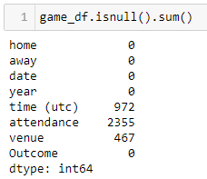
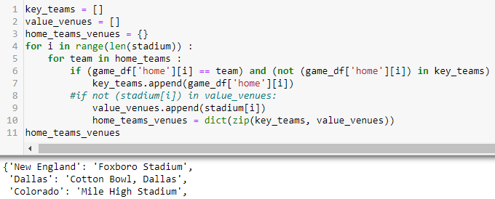
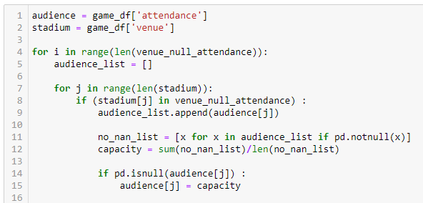
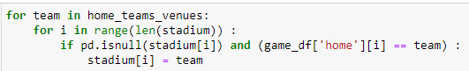

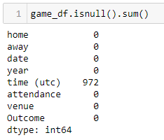
Data
Cleaning
BEFORE:
Created a dictionary by mapping home team to home venue to fill NULL “venue” as follows,
Filled in NULL ‘attendance’ using code-block as follows,
AFTER:
Notes:
Daniel:
Data cleaning was the most time-consuming in this project, as we’ve got dataset with plenty of NULL values.
The snapshot of codes and functions show how we cleaned up TWO KEY COLUMNS to fill in the NULL row entries.

Slide 8

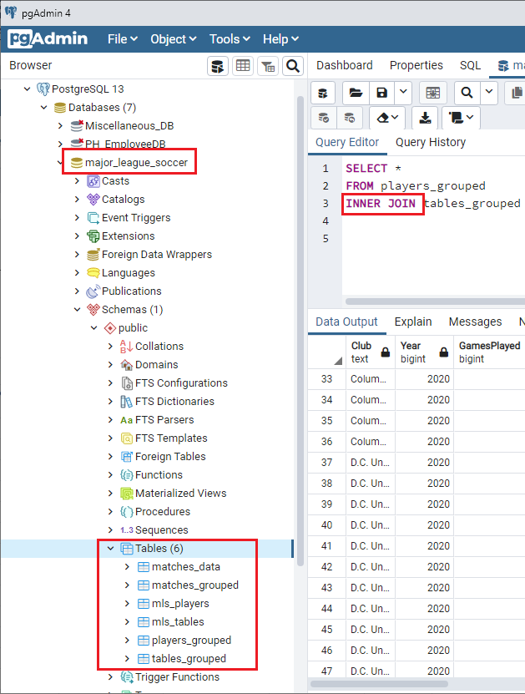
Database in PostgreSQL
Created a database “major_league_soccer” in PgAdmin
Exported 6 cleaned DataFrames to SQL tables
2 tables are joined using SQL Query
Imported data from SQL Database for ML Preprocessing
Notes:
Daniel:
Created DB > Stored clean datasets into DB > imported data from DB for ML processing.

Slide 9








Technologies Used
Notes:
Daniel

Slide 10

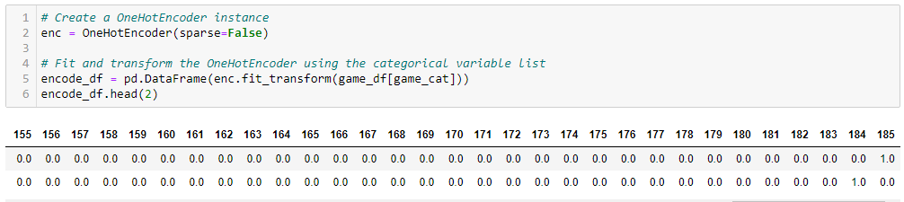

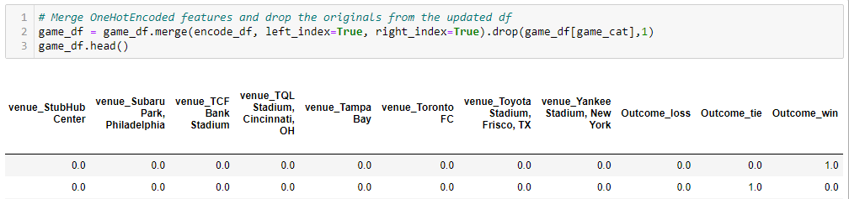

Deep Learning Model - Why ?
We’ve labeled, historic data for Supervised learning algorithm e.g., SVM, NN, Random Forest etc.
Neural Network provides better accuracy and deals better with non-linear relationship.
Data Preprocessing:
Merging encode_df with original game_df:
Notes:
Moonem:
Before

Slide 11

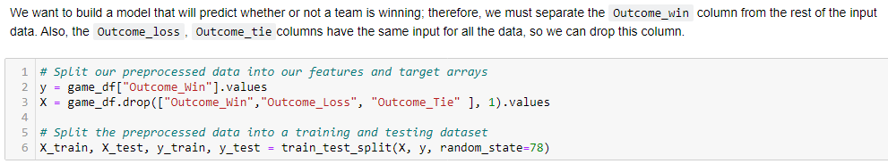
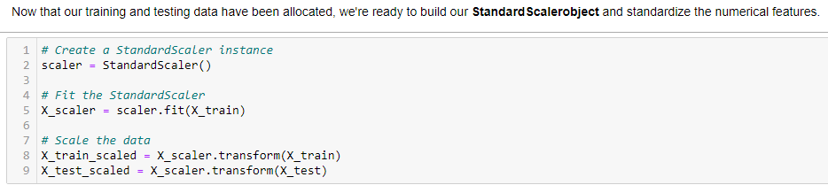

Deep Learning Model (continued)
Define features and output:
Standardizing training and testing dataset:
Notes:
Moonem:

Slide 12
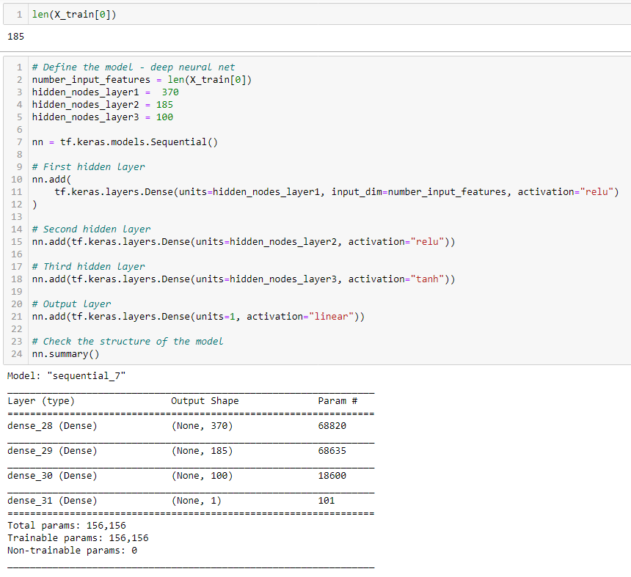
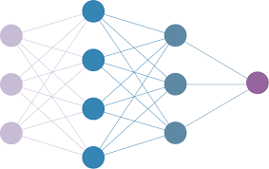
Deep Learning Model (continued)
Define neural network:
Notes:
Moonem:

Slide 13

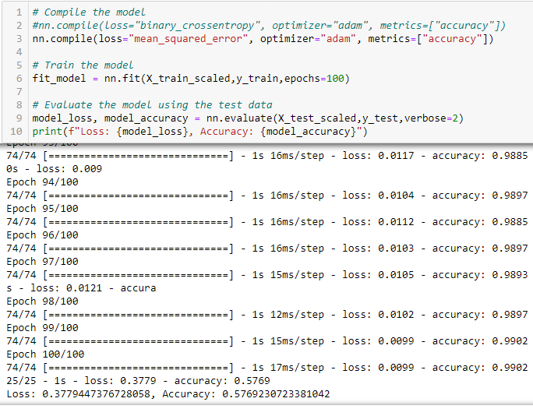
Deep Learning Model (continued)
Compile and Evaluate the neural network model:
Finding:
A team outcome for “Win” in a game is 58% accurate.
Observation:
The accuracy of the model seems “fair enough”.
We’ve checked back, cleaned more data, optimized parameters and accuracy improved from 53% to 58%.
Notes:
Moonem:

Slide 14
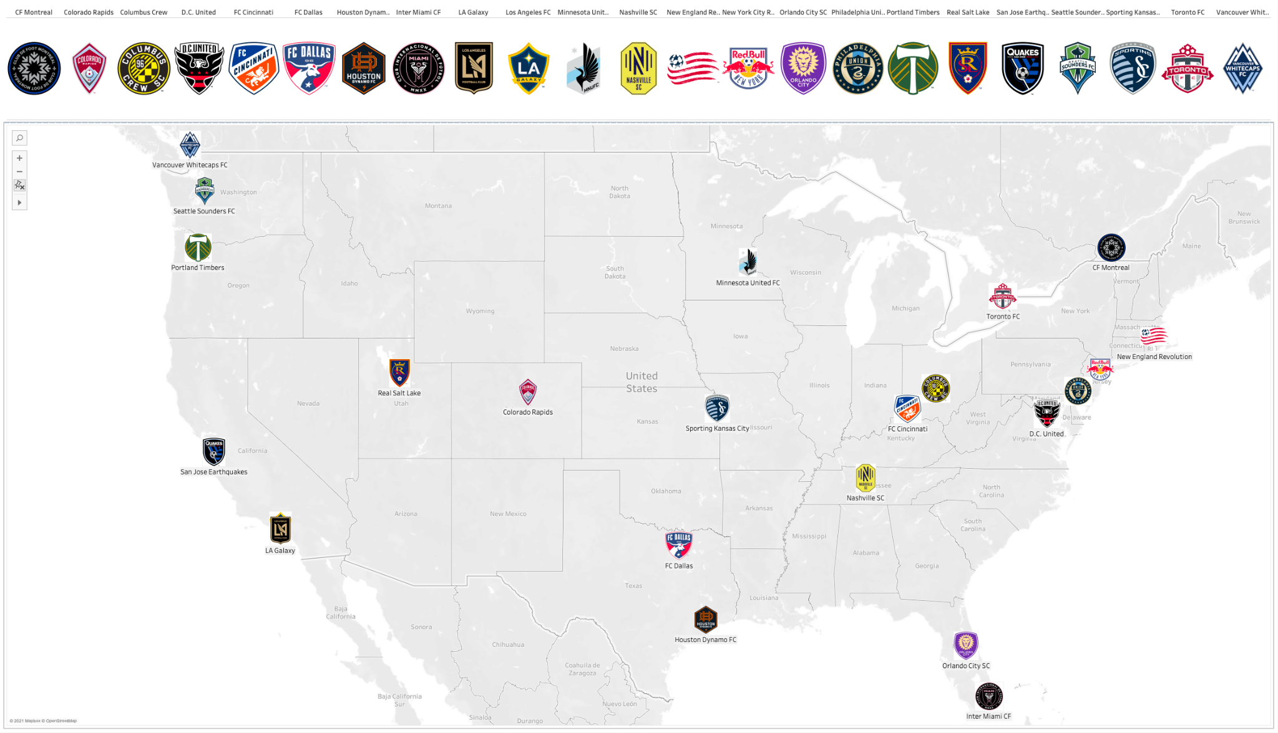
Dashboard on Major League Soccer matches - 1
Location wise MLS Clubs
Notes:
Sean:

Slide 15
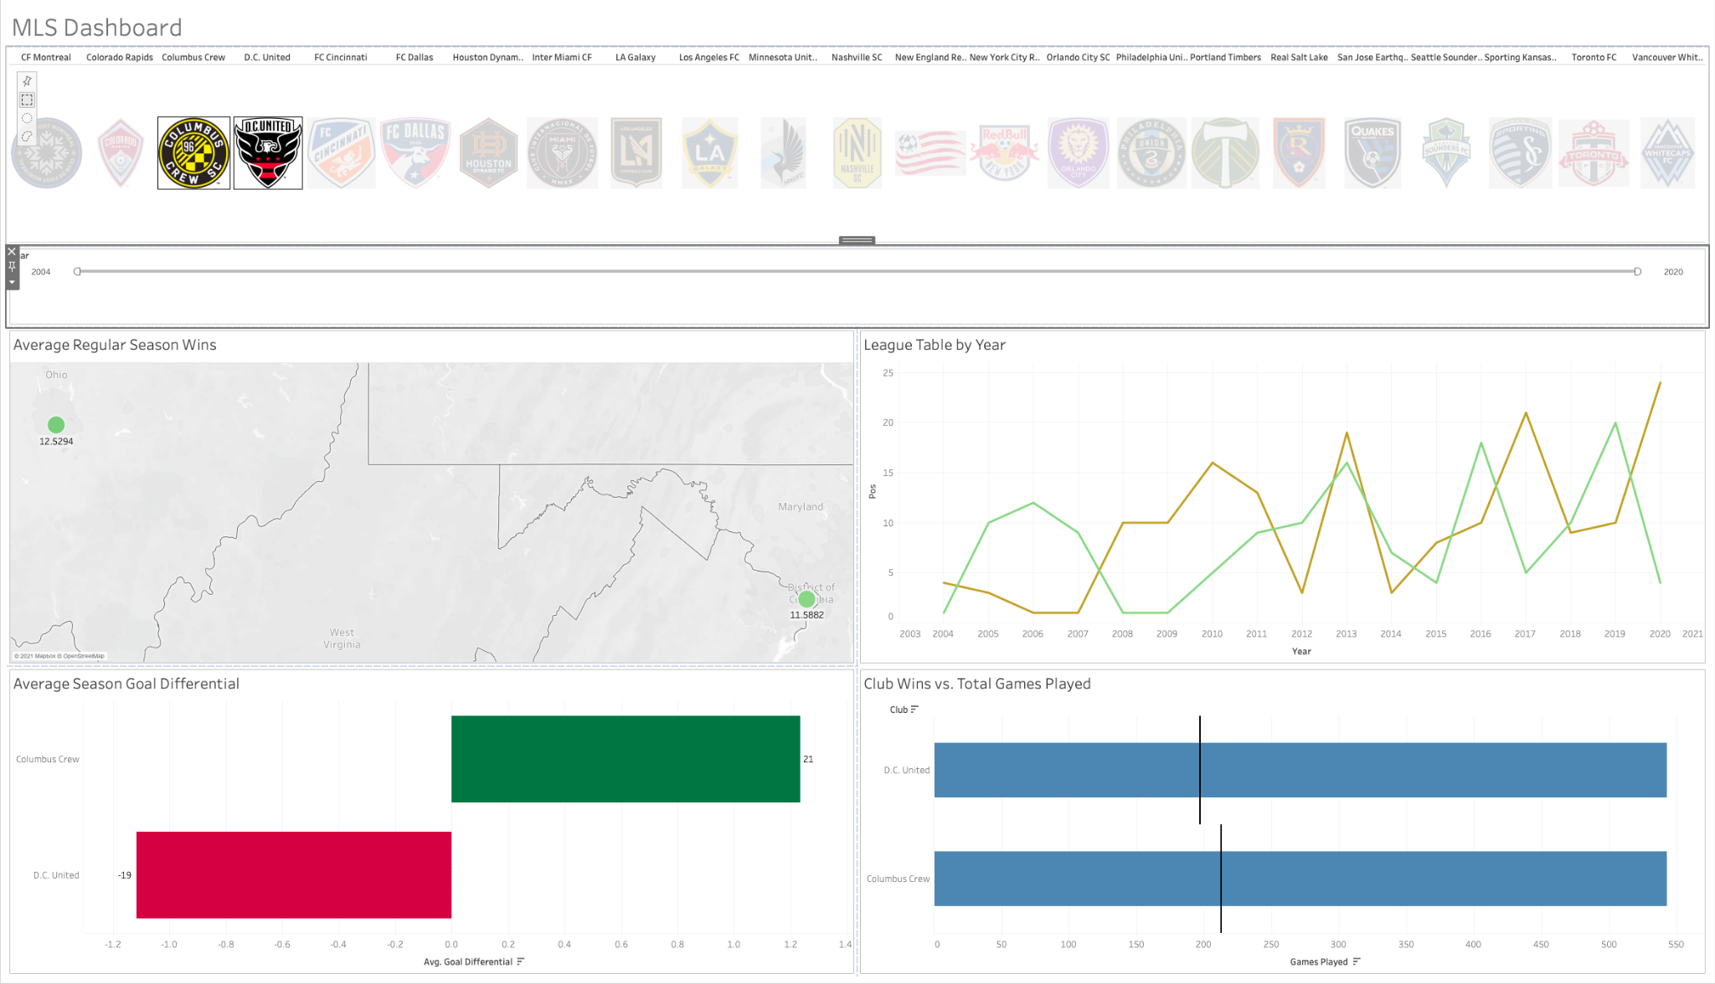
Dashboard on Major League Soccer matches - 2
Showing “MLS Dashboard”:
Data on two Clubs chosen
Notes:
Sean:

Slide 16
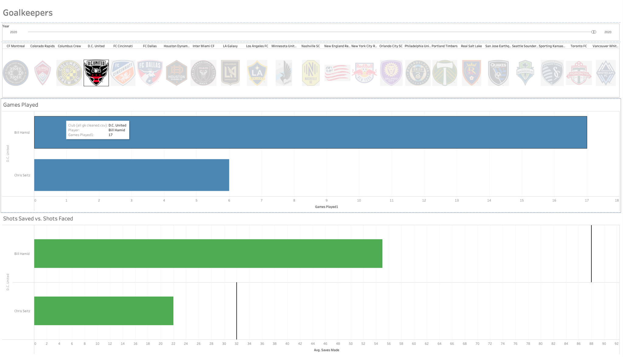
Dashboard on Major League Soccer matches - 3
Showing Goalkeepers data for Club “S.C. United”
Notes:
Sean:

Slide 17
Dashboard on Major League Soccer matches - 4
MLS_Dashboard_Demo.mov https://drive.google.com/file/d/1tDt5H8qEujCfAFWTHFXx7RLfz_4uyTQe/view?usp=sharing
Link to the Google drive for the .mov file:
https://drive.google.com/file/d/1tDt5H8qEujCfAFWTHFXx7RLfz_4uyTQe/view?usp=sharing
Notes:
Sean:

Slide 18
?
Thank You
Notes:
Sean:

